Slide 1
TRANSLATING HATRED & humour
What our stereotypes and clichés tell about us.
James Underhill
rep-univ-rouen.fr, University of Normandy

Slide 2
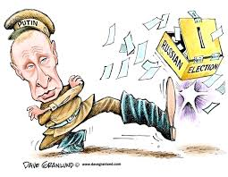
Putin Cossack Dictaror?

Slide 3
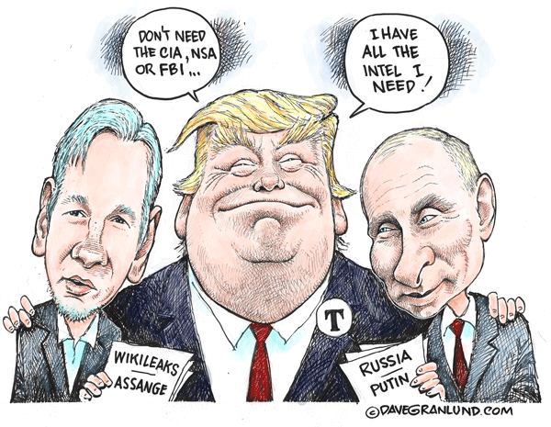
An idiot? Easily manipulated

Slide 4
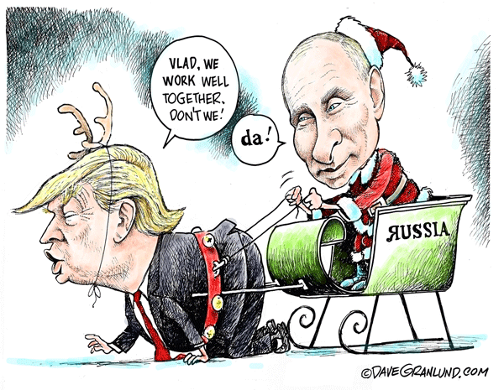
Who rules who?

Slide 5
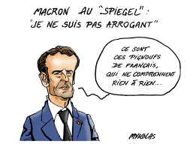
The Arrogant French king of the arrogant french?

Slide 6
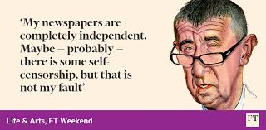
People we love to ridicule & Hate

Slide 7
Universal laughter?
Let’s start with two widely held beliefs.
Well-founded beliefs? Or simply personal convictions?
We all like a good laugh.
All you need is love.
Smějeme se rádi, všichni
Všechno, co potřebujeme, je láska.

Slide 8
Three univERSAL (???) Principles
Principle number one: humour is universal
Principle number two: love is universal
Do we need a Principle Number Three: hatred is universal?

Slide 9
Ethnolinguistics and hate
In the field of ethnolinguistics and cultural studies:
Are humour and hatred universal?
What do we hate?
Why do we hate?
And how do we express our hatred?
And how do hatred and humour often go together?

Slide 10
Do good patriots always hate?
It is said that often in order to be a good patriot one is the enemy of the rest of mankind.
To be a good patriot…
…to wish for one's country's greatness is to wish harm to one's neighbours.
He who should wish that his fatherland might never be greater, smaller, richer, poorer, would be the citizen of the world.
Voltaire

Slide 11
Racist jokes: community strategies?
Is Humour less about fear?
And more about resentment?
Racist clichés and racist jokes usually reveal how one community – usually the dominant community – despises minorities.
Let’s take a look at some American racist and jokes.

Slide 12
Lazy latinos, crimminal blacks & German nazis
How does a black woman fight crime? Getting an abortion.
What does a black child get for Christmas? Your bike.
Racism is like black people. It shouldn't exist.
What do you get when you cross a Mexican and a black person? Somebody too lazy to steal.
What do you call a building full of Mexicans? Jail
Why do Mexican kids walk around school like they own the place? Because their dads built it and their moms clean it.
A young German boy is rushed to the hospital half-dead, plagued by coughing fits and spasms According to his parents, he accidentally used the guest shower.

Slide 13
What do you laugh at? Who? Why?
There may be similar jokes in your country.
Before we start denouncing the Americans for their prejudices, we would perhaps do well to consider out own prejudices.
Who do we resent and denigrate?

Slide 14
Jokes reveal stereotypes
But what do these jokes reveal?
A prevalent tendency to consider the following groups in the following terms:
Latinos are lazy
Blacks are criminals
Germans are Nazis.

Slide 15
Our jokes tell us about us
These prejudices tell us little or nothing about the groups denigrated, but they tell volumes about the stories most white Americans like to tell about themselves.
Self-image reflected in these jokes:
Americans are :
hard-working,
law-abiding,
good world-citizens who believe that everyone was created equal.
Americans are willing to go out into the world to save other peoples from regimes that oppress them.

Slide 16
Others structure identity
The Americans are the non-lazy Latinos,
they are the non-criminal blacks,
the non-fascist Germans.
‘Others’ – invented others
Fictitious fantasy others – are used to construct identities.
Do Americans believe them?
Don’t we all enjoy Disney and our own fairy tales about the world, the good and the evil?
We love to remind ourselves we are on the right side: NOT LIKE THEM!!!

Slide 17
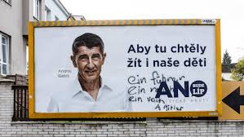
Nazis in Czech identity and czech politics?

Slide 18
Details are downplayed
When the Americans saved Europe…
Several ‘details’ are carefully downplayed in this narrative.
The British resistance to the Germans from the beginning to the end of the war.
The Russian resistance

Slide 19
Subplots are integrated
French cowards
Why do the French have trees along their avenues
So the Germans can march in the shade.
Perverted untrustworthy moralizing French

Slide 20
Evil two-faced frenchman you can’t trust him… He sounds good, but…

Slide 21
The good guys are stong and good and loved by women

Slide 22
Universal humour? Jokes about women?
Jokes about Blondes
A blonde goes into a library and says:
I’ll have a big mac and a large fries.
I’m sorry miss, says the librarian, but you’re in a library.
‘Oh, I’m sorry,’ whispers the blonde, ‘I’ll have a big mac and a large fries.’

Slide 23
Women laughing at women
Who?
Why?
Hate or resentment?
Competition?
All American girls?

Slide 24
Satirizing shakira the bomba latina

Slide 25
Hating the west coast california girls

Slide 26
What women Hate
Shakira’s curves and postures are mocked by less sexy women clearly intimidated by the ‘bomba latina’:
Katey Perry is mocked for her simplistic girlish prick-tease poses and dresses in a variety of spoofs and satires.
Pop videos also have a lot of prejudice and resentment.
In Shakira’s videos we can see a Kick Ass heroine of GRRRRRL Power deflating the false enormous breasts of her rival when she tries to take her partner.

Slide 27
Resenting bomba latina
Hating California girls
Shakira spoof
Satire reveals resentments and fears:
Americans are competitive
And american girls compete
Or can’t compete
Can we compete with the sunshine girls of the West Coast?
And should we try?
Try to please….. ……………………………..Men?

Slide 28
Sexual jokes are violent jokes
Sexual parts exploited
Castration
Breasts,
vaginas

Slide 29
Provisional Conclusions Working hypotheses
Jokes tell us little about those that are ridiculed.
The objects of derision invariably serve as opposite-others used to define the majority culture’s values
Men’s jokes about women tell us nothing about women, but a lot about men.
Women’s jokes about men tell us little about men, but a lot about women.
Men’s jokes about men tell us about their ideals, their values, their fears and resentments.
Women’s jokes about women tell us about their ideals, their values, their fears and resentments.

Slide 30
Do political leaders laugh?

Slide 31
Subjects or objects of humour?

Slide 32
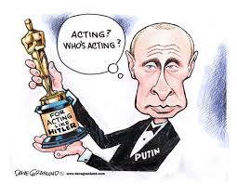
Are political leaders amusing?

Slide 33
Freundlich putin? Amusing and witty in German, English and russian? Politcal charm?

Slide 34
Is this not ‘our’ Putin?

Slide 35
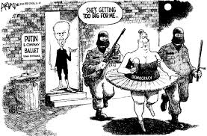
KGB elliminating democracy

Slide 36
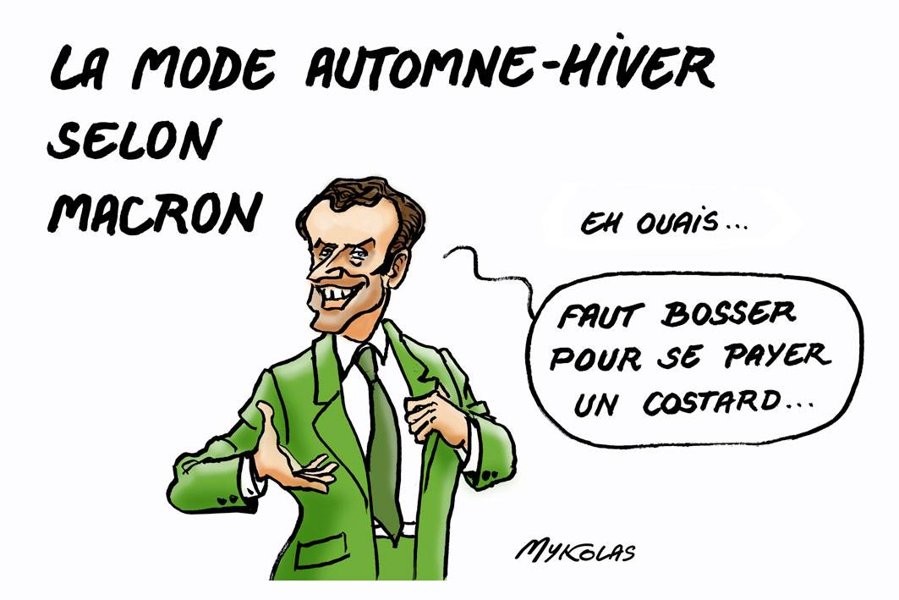
I work hard to get my great suits

Slide 37
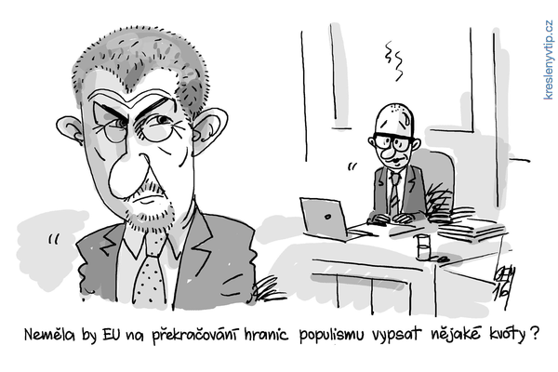
EU Quotas on populism?

Slide 38
What clichés and stereotypes are in play here?
The French are arrogant and Americans idiots, naive and easily manipulated.
Trump is a prototypical American
The Russians are sly manipulators, not to be trusted. The Russians hate Europe. Russians use gas control to control political outcomes in Europe. Russians are cossaks kicking democratic elections to one side.
Putin is a violent macho Putin is an enemy of democracy and will try to destroy it. Putin is humourless.
Babiš is a Slovak fascist : Husak was a Slovak

Slide 39
What our humour says about us
French are arrogant when it comes to the Americans & the Belgians.
Americans like to see themselves as the heroes, the sheriffs that save the world.
The Europeans are eurocentric
Are Švejk and švejkování are back again?
Are the Czechs responsible for their democracy?
And for their fate?

Slide 40
Why can’t our leaders be funny?

Slide 41
Humour humanizes
We won’t let our leaders laugh
We laugh at them
We transform our political actors into objects
Objects of hate and derision

Slide 42
Humour Humanizes
They can’t laugh sense of humour would make them intelligent
Make them human

Slide 43
We prefer our clichés They let us hate in peace
Europeans prefer our Putin,
the tyrant of his people
the aggressive belligerent trouble-maker.
We turn out leaders into stereotypes that are larger than life,
When Putin threatens sanctions, he is a capricious. When he authorizes military interventions he is a tyrant invader.
Do we want to understand the geopolitical context: our position in the international community?

Slide 44
We enjoy our sense of humour
Ethnolinguistics asks us to ask who we are and what we do when we laugh at others
As men and women
As communities
As cultures and nations
As Europeans

Slide 45
References
Bartminski, Jerzy, Aspects of Cognitive Linguistics, London: Equinox, 2012.
Underhill, James, Ethnolinguistics and Cultural Concepts: truth, love, hate & war, Cambridge: Cambridge University Press.
Walas, Tereza, (edited & translated), Stereotypes & Nations, Crakow, International Cultural Centre Crakow, 1996.

Slide 46
Webography
http://www.gutenberg.org/files/35622/35622-h/35622-h.htm
https://www.bing.com/videos/search?q=clint+eastwood+film+racist&&view=detail&mid=DB6695BB7867A5466AC6DB6695BB7867A5466AC6&&FORM=VDRVRV
https://www.bing.com/videos/search?q=clint+eastwood+film+racist&&view=detail&mid=C9DC6DA622050DB11D11C9DC6DA622050DB11D11&&FORM=VDRVRV
https://www.reddit.com/r/MeanJokes
Shakira satire https://www.bing.com/videos/search?q=shakira+satire+pancake&&view=detail&mid=83E7E55B9FE495960BE183E7E55B9FE495960BE1&&FORM=VRDGAR
Miley Cyrus satire
https://www.bing.com/videos/search?q=miley+cyrus+satire+wrecking+ball&view=detail&mid=456D27F3A31E750C8BA8456D27F3A31E750C8BA8&FORM=VIRE
Kesha satire
https://www.youtube.com/watch?v=d7n8GqewJ2M
Katey Perry satire
https://www.bing.com/videos/search?q=katey+perry+satire+california+girls&&view=detail&mid=946E16A6FC5BD7FF102B946E16A6FC5BD7FF102B&&FORM=VRDGAR
Putin Satire (Cookin with Putin)
https://www.bing.com/videos/search?q=cookin+with+putin&view=detail&mid=74FA251F5D5A3A8C1EAB74FA251F5D5A3A8C1EAB&FORM=VIRE
La Fontaine
http://www.lafontaine.net/lesFables/afficheFable.php?id=47

